Slide 1
There are two effects deterring the distribution of the P_{miss} direction
  The direction of the P_{miss} vector which is expected to be uniform and therefore goes like phase space: 0 at 0,180º and maximum at 90º (due to solid angle factor sin(θ)*dθ*dφ)
  The selectivity due to the cross section (1/s¹⁰), which prefers nucleons with P_{miss} that have low s i.e going forward in lab frame
  The convolution of those two factors lead to a P_{miss} distribution with a preferred direction
X
=

Slide 2
The preferred direction at P_{miss} means there is a large P_{T} component
The large P_{T} component leads to the break-up of φ symmetry around 180º (see next slide)
The break up of φ symmetry leads to the preferred spots for trigger protons detectors detector placement that are not anymore 180º apart in φ
The fact that initially P_{miss}=-P_{recoil} leads to preferred direction also for P_{recoil} which can be studied through the correlation of the Δφ_{1,2} with φ_{recoil} (see slides 4-9 for details).

Slide 3
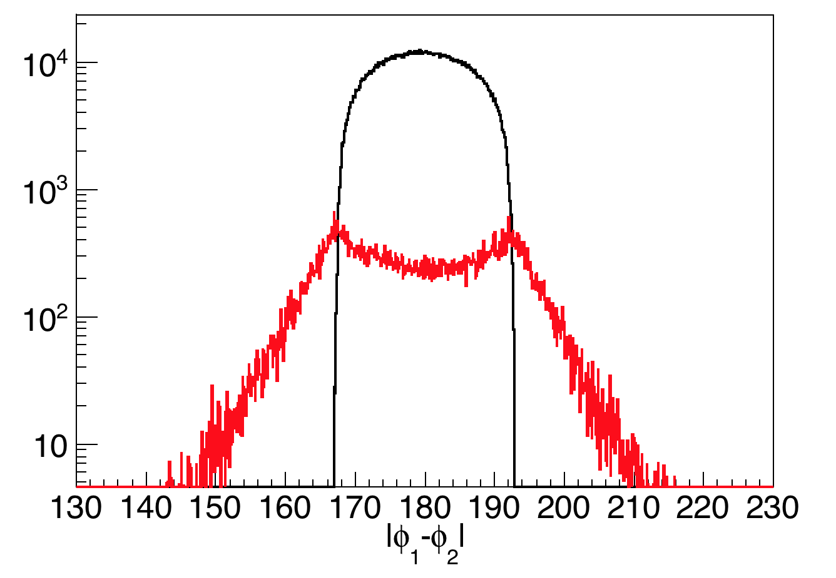
Difference of the azimuthal angles between the two leading protons for P_{miss}<0.25 GeV/c (black curve) compared to P_{miss}>0.25 GeV/c (red curve). Two peaks are present at the difference for P_{miss}>0.25 GeV/c and |s,t,u|>2 (GeV/c)² at 180±14.5.

Slide 4
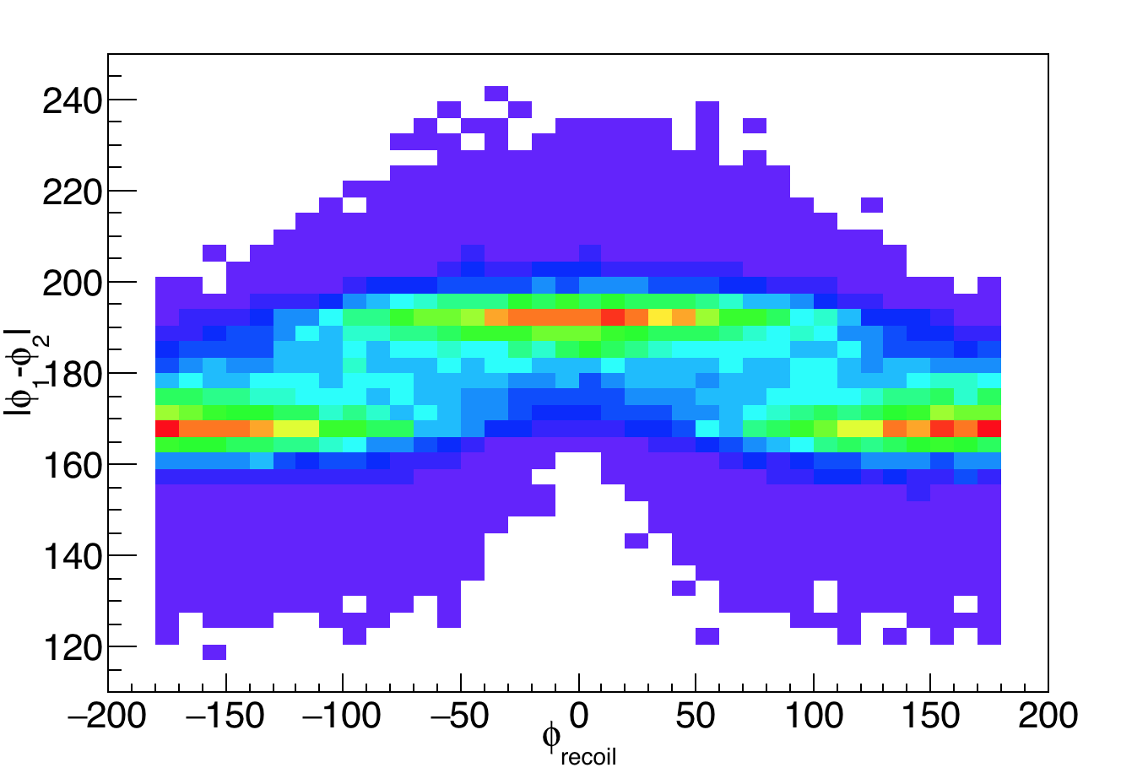
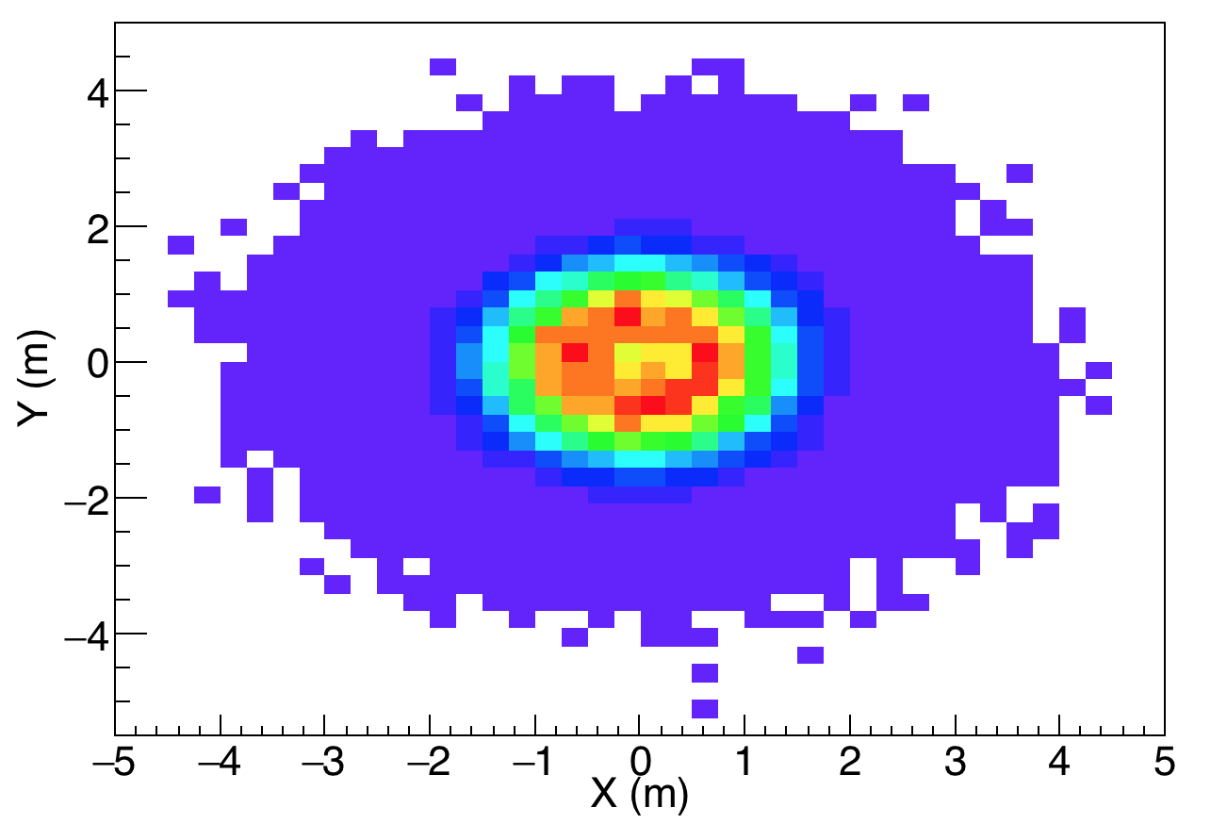
Correlation of Δφ=|φ₁-φ₂| with φ_{recoil}
Recoil events at NeuLAND plane (+14 m from the target) with ΝΟ cut due to the magnet
Beam Direction: inwards the screen
at position (x=0,y=0)

Slide 5
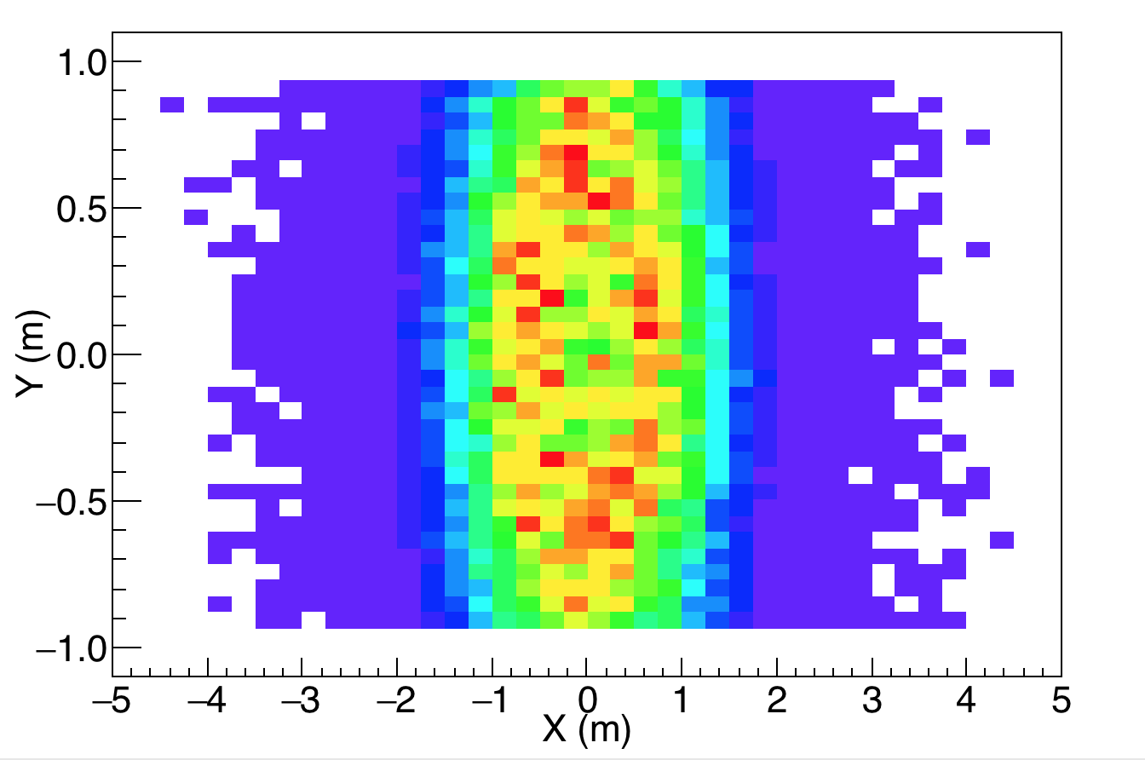
Correlation of Δφ=|φ₁-φ₂| with φ_{recoil}
Recoil events at NeuLAND plane (+14 m from the target) with cut due to the magnet
Beam Direction: inwards the screen
at position (x=0,y=0)

Slide 6
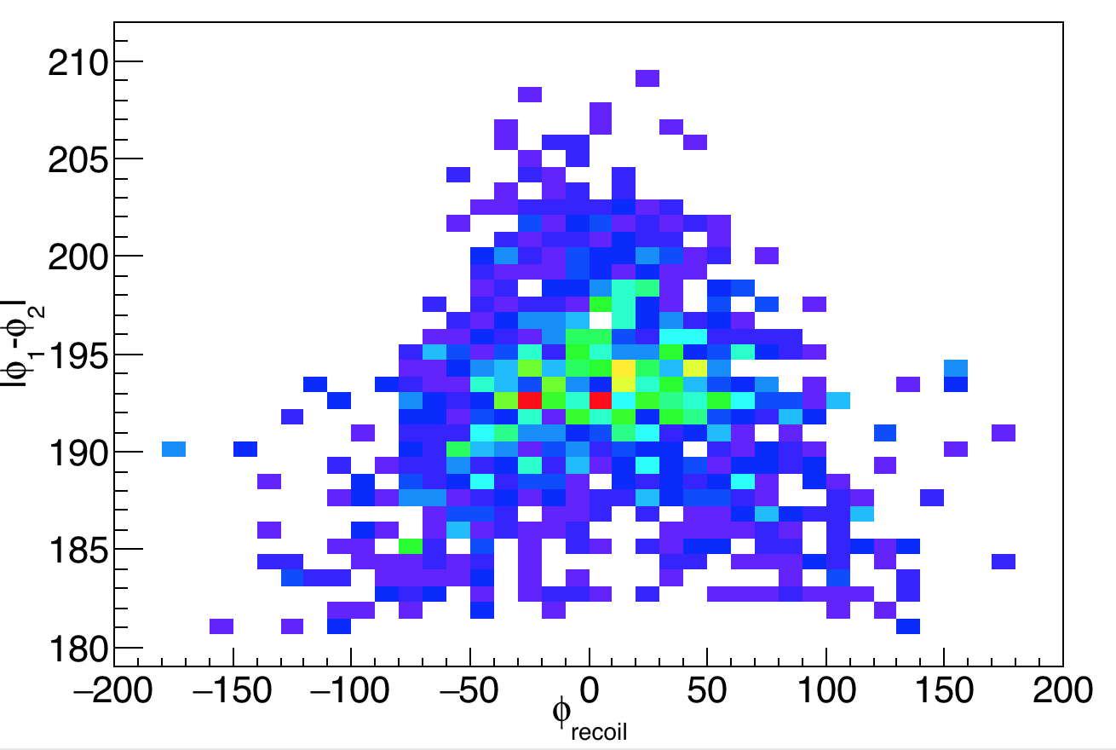
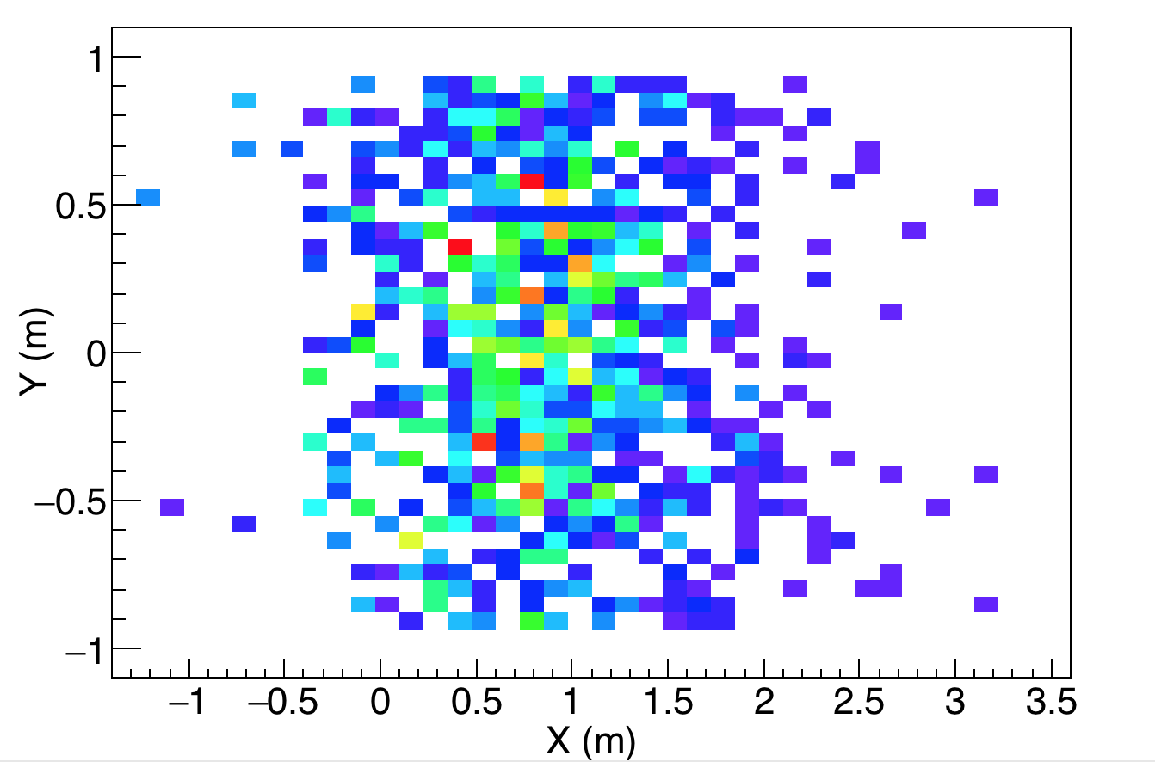
φ1=-90±7.5
φ2=104.5±7.5
104.5
-90
Moved to the right (NeuLAND)
Recoil centered around the horizon
Beam Direction: inwards the screen
at position (x=0,y=0)
Neutrons in NeuLAND/All Neutrons: 220/290

Slide 7
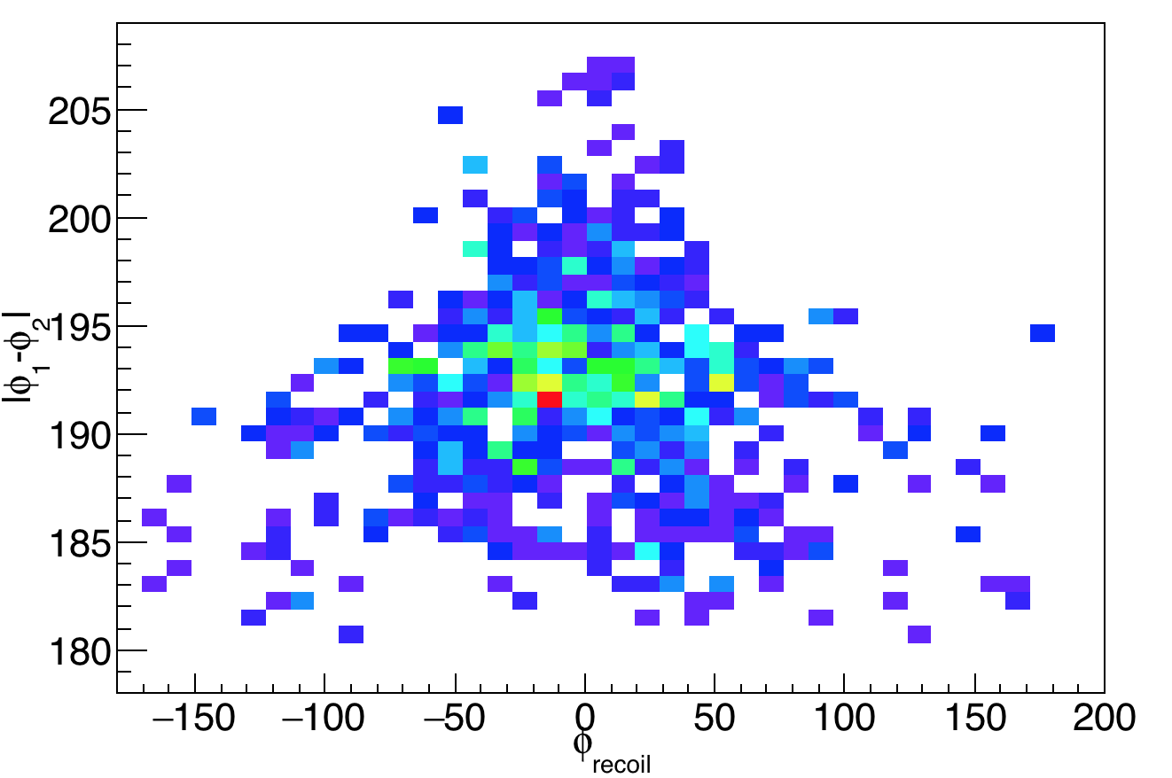
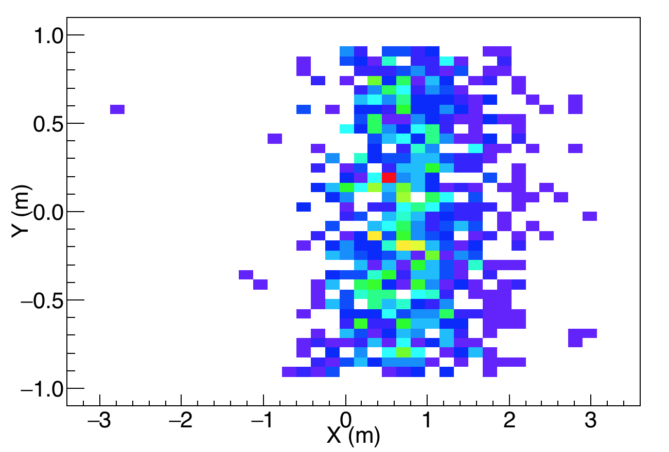
φ1=90±7.5
φ2=-104.5±7.5
90
-104.5
Moved to the right (NeuLAND)
Recoil centered around the horizon
Beam Direction: inwards the screen
at position (x=0,y=0)
Neutrons in NeuLAND/All Neutrons: 200/270

Slide 8
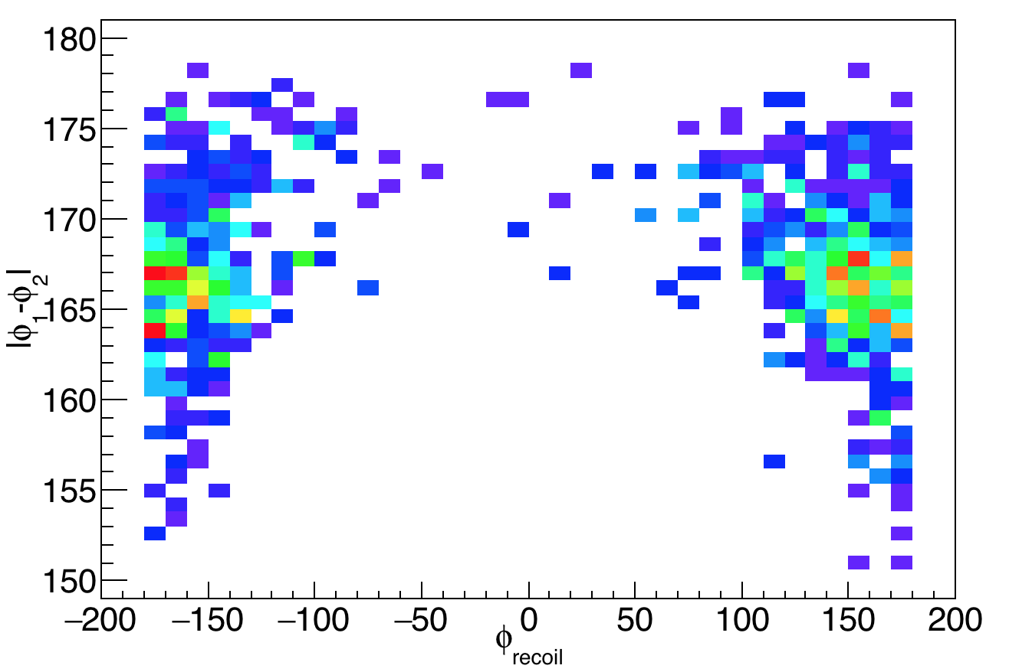
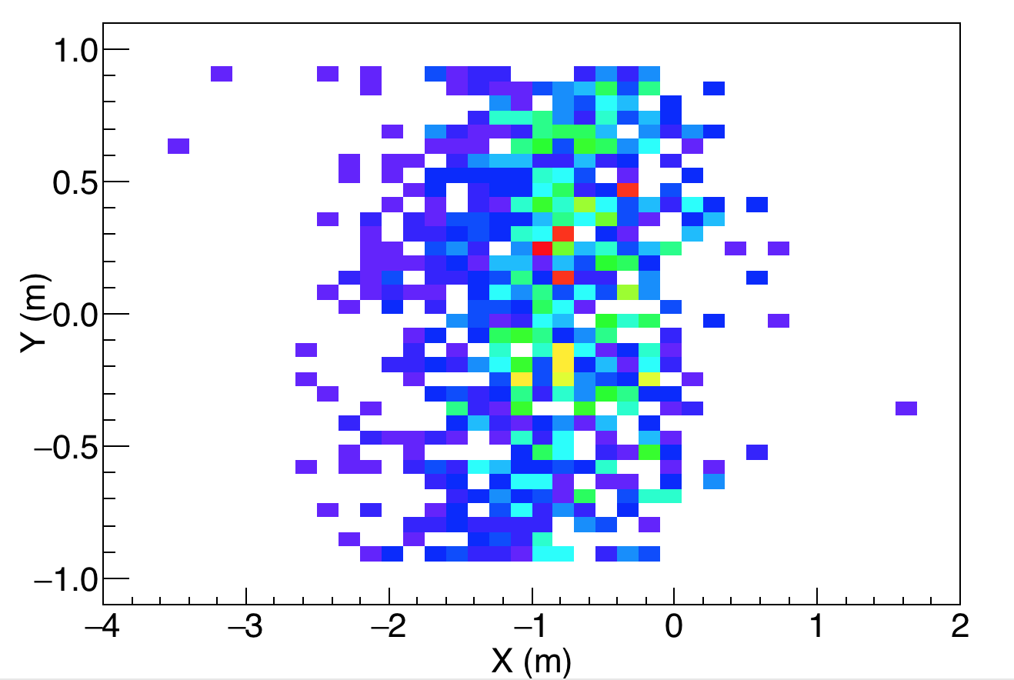
75.5
-90
φ1=-90±7.5
φ2=75.5±7.5
Moved to the left
Recoil centered around the horizon
Beam Direction: inwards the screen
at position (x=0,y=0)
Neutrons in NeuLAND/All Neutrons: 5/280

Slide 9
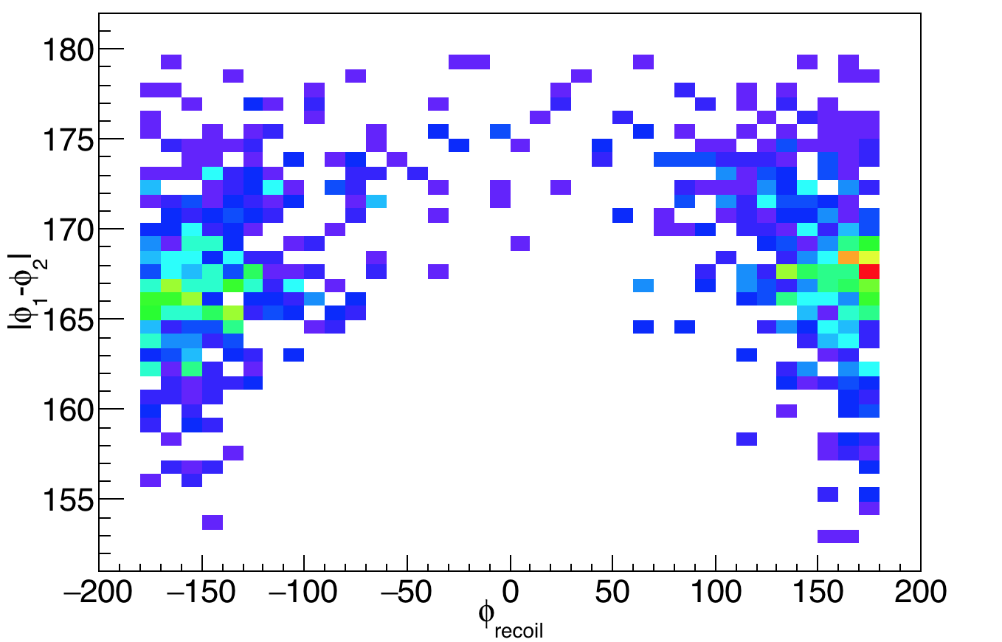
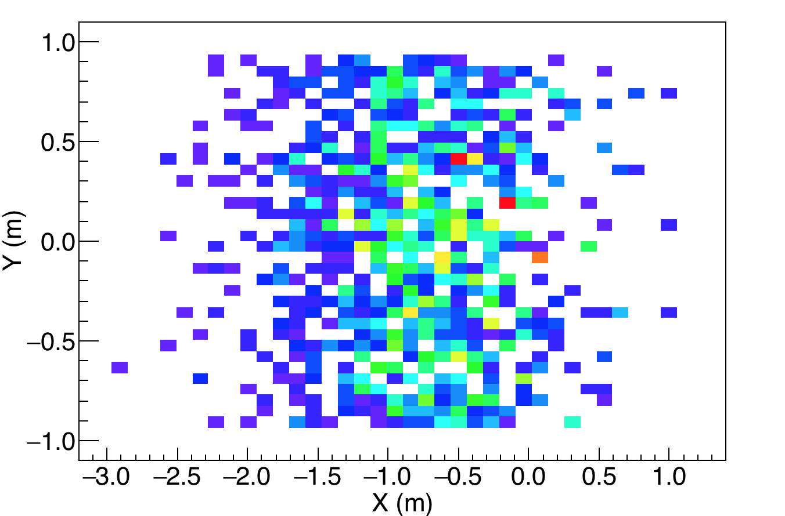
90
-75.5
φ1=90±7.5
φ2=-75.5±7.5
Moved to the left
Recoil centered around the horizon
Beam Direction: inwards the screen
at position (x=0,y=0)
Neutrons in NeuLAND/All Neutrons: 8/270

Slide 10
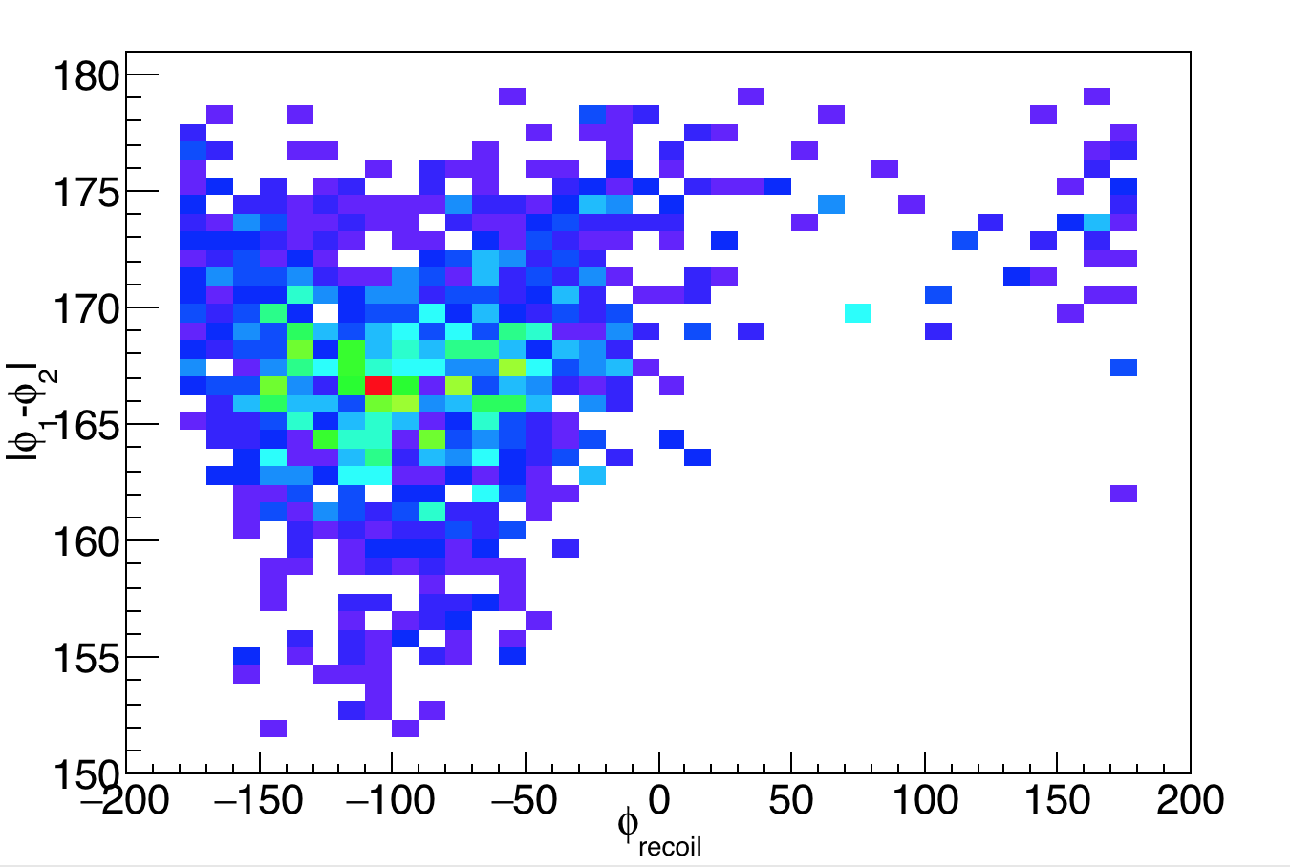
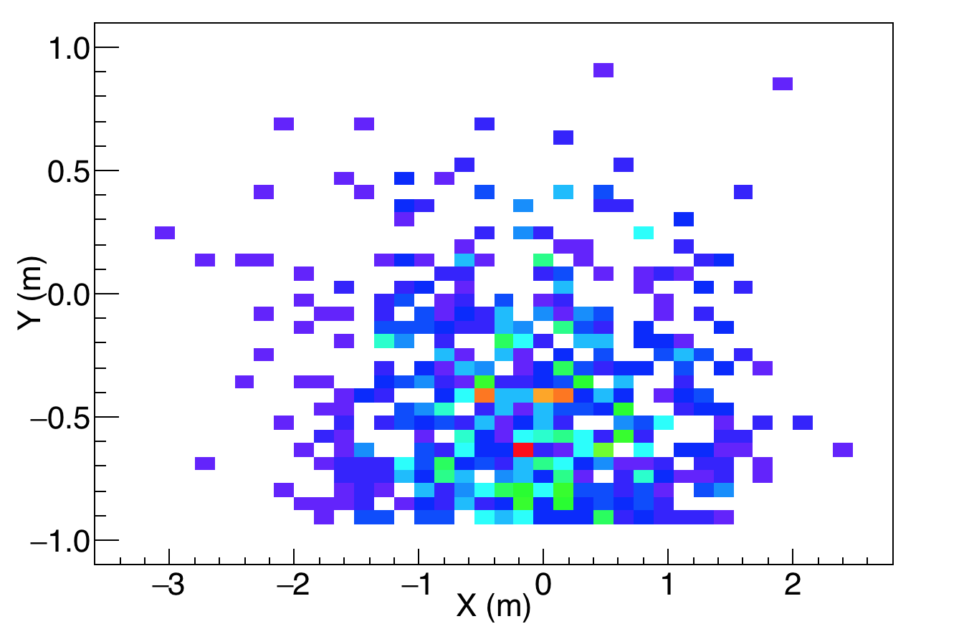
165.5
φ1=0±7.5
φ2=165.5±7.5
Moved down
Recoil goes down (negative φ )
Beam Direction: inwards the screen
at position (x=0,y=0)
Neutrons in NeuLAND/All Neutrons: 60/220

Slide 11
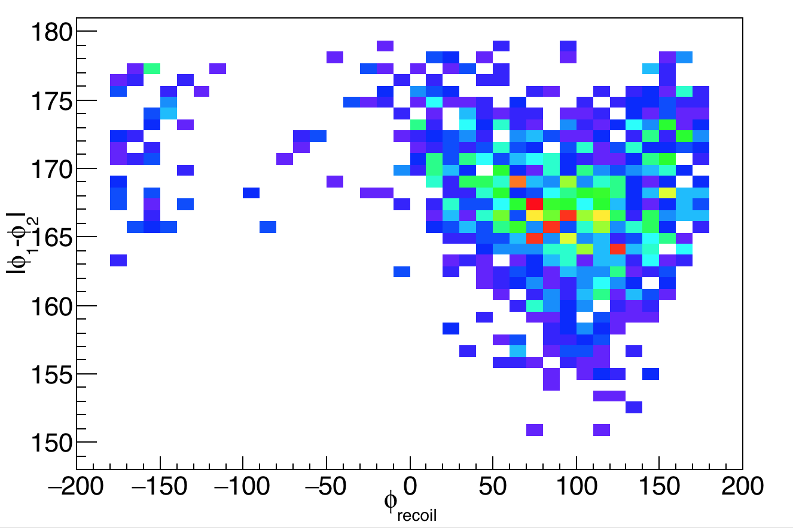
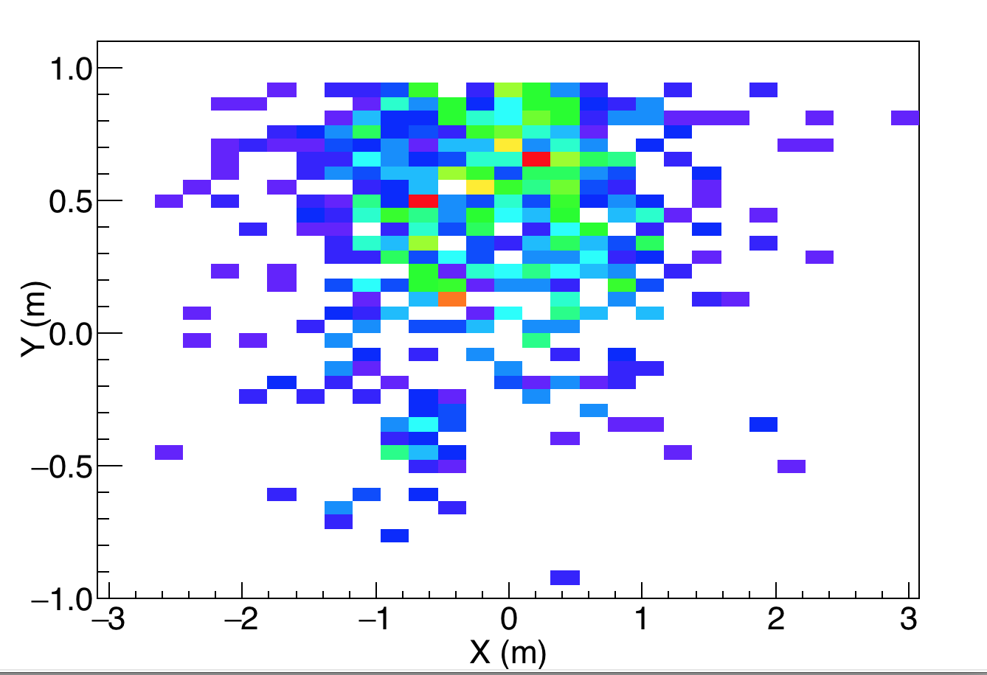
-165.5
φ1=0±7.5
φ2=-165.5±7.5
Moved up
Recoil goes up (positive φ )
Beam Direction: inwards the screen
at position (x=0,y=0)
Neutrons in NeuLAND/All Neutrons: 50/210

