Slide 1

Ξ ̶ reconstruction in Run 8
J. Drnoyan, V. Vasendina, A. Zinchenko, R. Zinchenko
30.04.2025
1

Slide 2
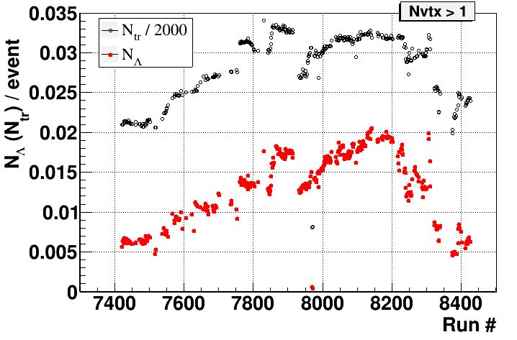
Steps towards Ξ ̶ analysis
100 runs with N_{Λ}/event > 0.017, ~60M events with reconstructed vertex (N_{vtx} >1)
Ξ ̶ selection in “platinum”, “golden” and “bronze” runs (19M)
Production Dec. 2024
“platinum” runs
“golden” runs
“bronze” runs
2

Slide 3
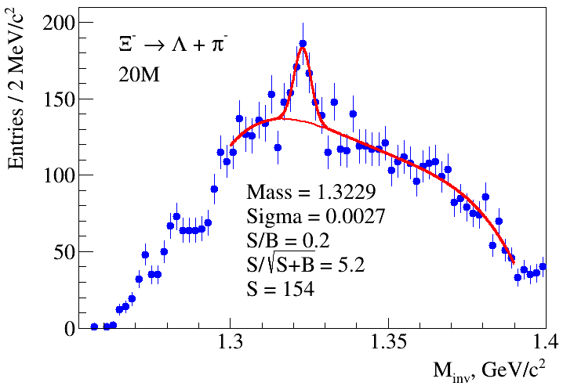
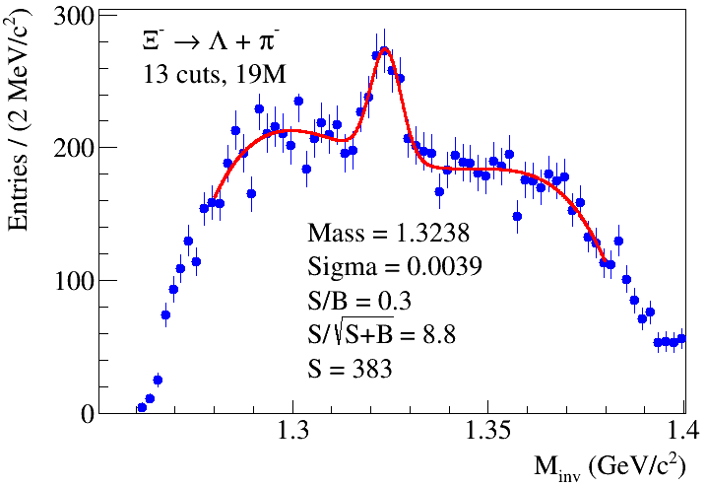
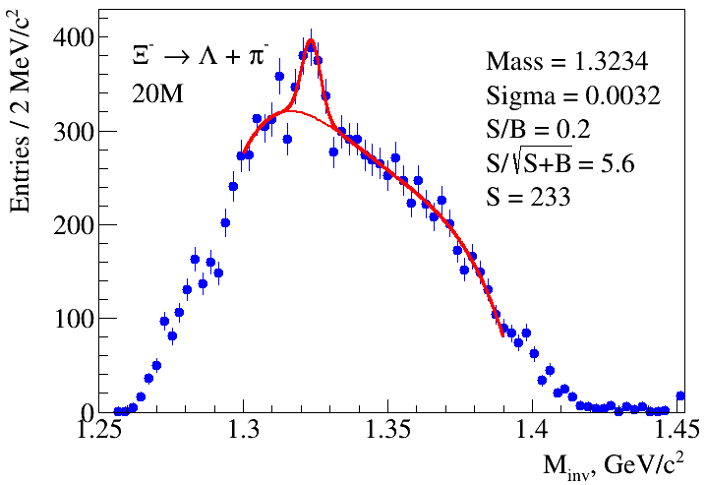
Ξ ̶ → Λ + π ̶ : old vs new production (~20M)
Production Dec. 2024, “golden” runs
Old production
3

Slide 4
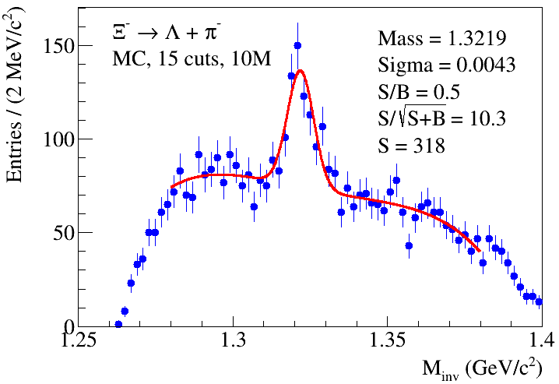
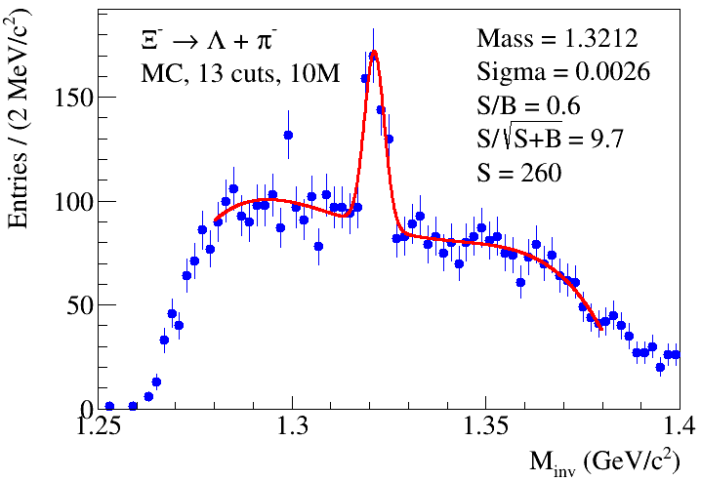
Ξ ̶ MC: 15 cuts vs 13 cuts
MC: DCM-SMM, 10M events
Selection cuts (13): “chi2s[0]>4&&chi2s[1]>2&&chi2s3[1]>5&&chi2s3[2]>3&&chi2h<10&&chi2L<10&&angle<0.02&&angL<0.07
&&distL<0.8&&path>3&&pathL>13&&c2pv<5&&d2pv<0.4“
“pts3[0]>0.1&& pts3[0]<0.4&&pts3[1]>0.05&&pts3[1]<0.4&&pts3[2]>0.2&&ppps3[2]>1”
“pathL>path&&abs(massL-1.1157)<0.00625”
4

Slide 5
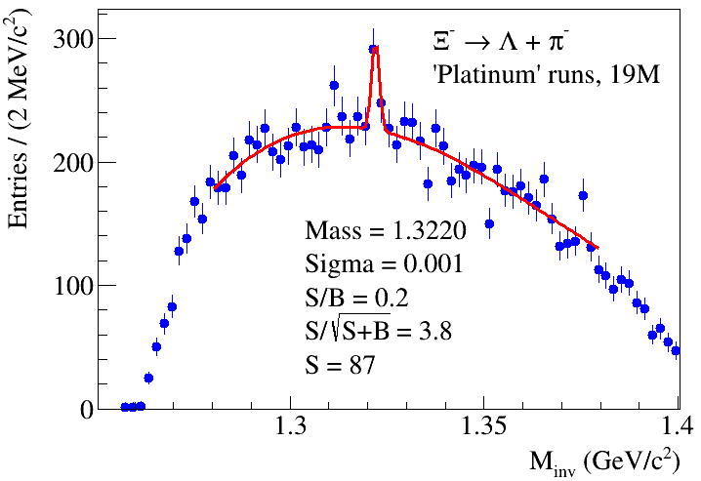
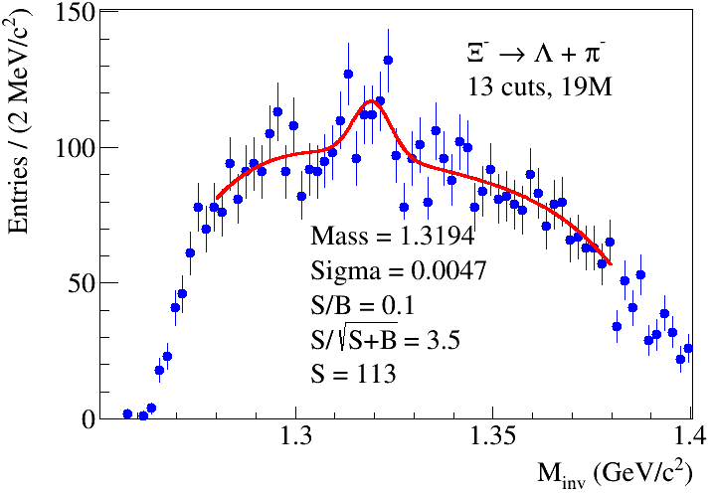
Ξ ̶ : “golden”, “platinum”, “bronze” runs
“Golden” runs “Platinum” runs “Bronze” runs
13 cuts for “golden” runs, 19M events
Selection cuts: “chi2s[0]>4&&chi2s[1]>2.5&&chi2s3[1]>6&&chi2s3[2]>3&&chi2h<10&&chi2L<7&&angle<0.02angL<0.07
&&distL<1&&path>2&&pathL>7&&c2pv<6&&d2pv<0.2”
“pts3[0]>0.1&&pts3[0]<0.4&&pts3[1]>0.05&& pts3[1]< 0.4&&pts3[2]>0.4&&ppps3[2]>1&&c2s3[0]<4&&c2s3[1]<4” “pathL>path&&abs(massL-1.1157)<0.00625”
5

Slide 6
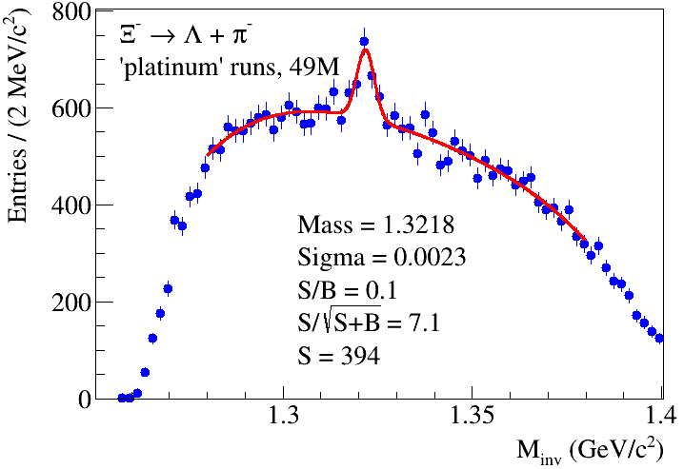
Ξ ̶ : “platinum” runs (cuts for “golden” runs)
Selection cuts: “chi2s[0]>4&&chi2s[1]>2.5&&chi2s3[1]>6&&chi2s3[2]>3&&chi2h<10&&chi2L<7&&angle<0.02angL<0.07
&&distL<1&&path>2&&pathL>7&&c2pv<6&&d2pv<0.2”
“pts3[0]>0.1&&pts3[0]<0.4&&pts3[1]>0.05&& pts3[1]< 0.4&&pts3[2]>0.4&&ppps3[2]>1&&c2s3[0]<4&&c2s3[1]<4” “pathL>path&&abs(massL-1.1157)<0.00625”
6

Slide 7
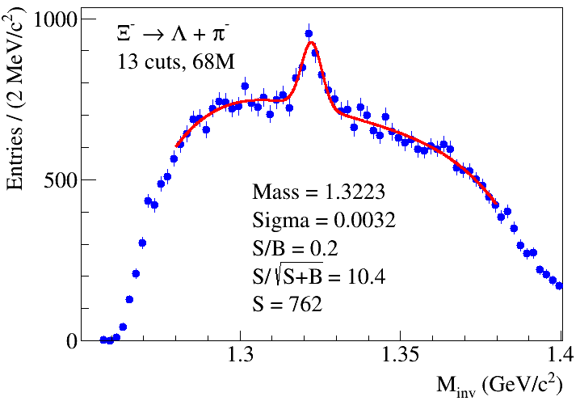
Ξ ̶ : “platinum”+”gold” runs (cuts for “golden” runs)
Plans: cuts selection for all “platinum” runs and “gold”+”platinum” runs
7

Slide 8
Ξ ̶ : “platinum”, “golden” runs
Golden runs: 7830, 7865, 7868, 7870, 7873, 7876, 7877, 7878, 7880, 7885, 7887, 7891, 7892, 7894, 7896, 7897, 7899, 7900, 7901, 7903, 7904, 7905, 7906, 7908, 7912, 7914
Platinum runs: 8026, 8045, 8046, 8047, 8048, 8050, 8051, 8052, 8053, 8058, 8059, 8061, 8063, 8066, 8074, 8076, 8079, 8080, 8081, 8084, 8086, 8087, 8088, 8090, 8100, 8101, 8102, 8104, 8106, 8109, 8110, 8112, 8113, 8116, 8117, 8119, 8122, 8123, 8124, 8129, 8130, 8131, 8133, 8137, 8138, 8139, 8142, 8158, 8159, 8160, 8161, 8170, 8173, 8174, 8175, 8183, 8184, 8186, 8188, 8190, 8193, 8195, 8196, 8198, 8199, 8202, 8221, 8228, 8229, 8230, 8231, 8232, 8305, 8306,
8

