Slide 1

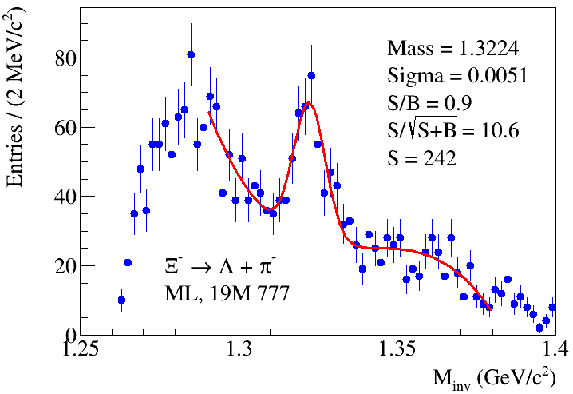
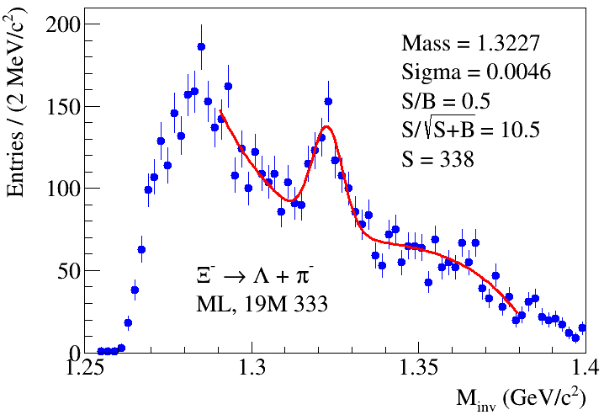
Ξ ̶ : “golden” runs (19M)
Using TMVA-BDTD for good / fake track discrimination
Cuts: “chi2s[0]>4&&chi2s[1]>2.5&&chi2s3[1]>5&&chi2s3[2]>3&&chi2h<14&&chi2L<9&&angle<0.02&&angL<0.04&&distL<2
&&path>3&&pathL>5&&c2pv<6&&d2pv<0.3ppps3[2]>1&&tmvas[0]>0.0&&tmvas[1]>0.0&&tmvas[2]>-0.01
&&(abs(xi.massL-1.1157)<0.00625”
13.05.2025
A. Zinchenko
1

