Slide 1
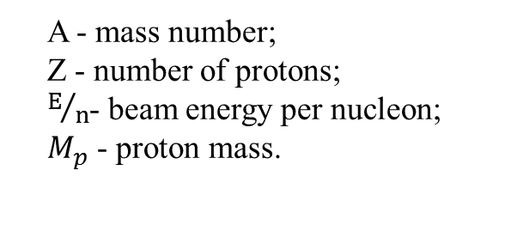
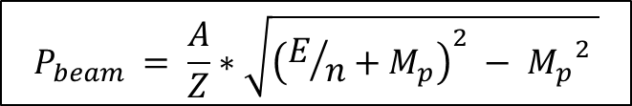
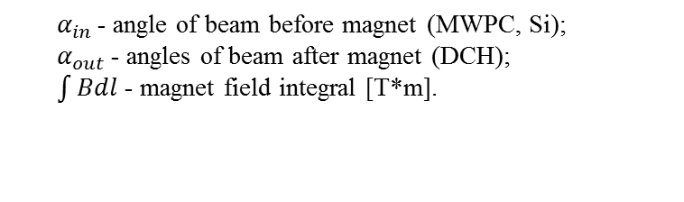
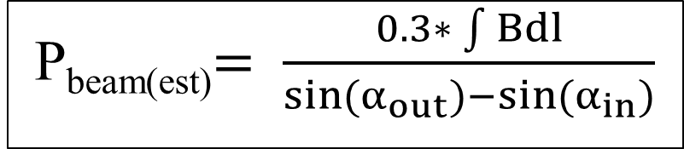
DCH alignment and beam momentum
A - mass number;
Z - number of protons;
$E/n$- beam energy per nucleon;
$M_{p}$ - proton mass.
$$P_{beam} = \frac{A}{Z}∗\sqrt{{\left(E/n+M_{p}\right)}^{2} − {M_{p}}^{2} }$$
P_beam = 7.0 GeV
P_{beam(est)}$= \frac{0.3∗ \int{Bdl}}{\sin{{(α}_{out}{)−sin(α}_{in})}}$
$α_{in }$- angle of beam before magnet (MWPC, Si);
$α_{out }$- angles of beam after magnet (DCH);
$\int{Bdl}$ - magnet field integral [T*m].

Slide 2
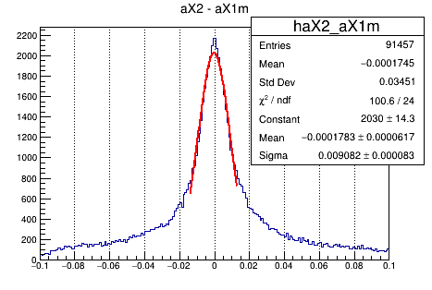
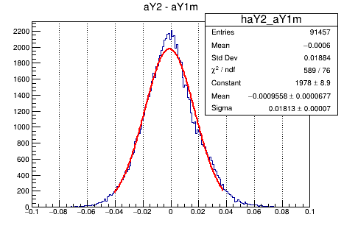
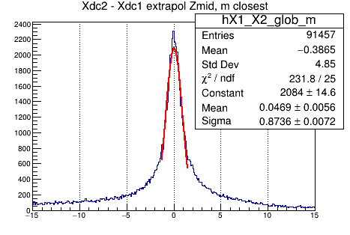
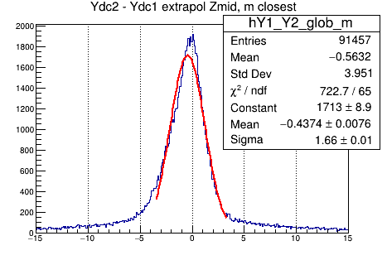
Alignment procedure
DC 1
DC 2
Z_mid
Z
~200 cm
Slopes in both chambers must be equal
The segments extrapolated in z_mid must meet in the same point

Slide 3
FIRST way
DCH1 fiducial;
DCH2 slope and coords adjusted so two chambers are parallel and the segments are pointing to the same point at z_mid
X2_slope_shift = -0.005 rad;
X2_coordinate_shift = -5.99 cm;
P = 7.68 GeV
P_beam = 7.0 GeV

Slide 4
SECOND way
As the magnet and DCH were not moved since last data tacking the GEM-DCH alignment for Run7 SRC can be used.
X1_slope_shift = 0.003 rad;
X2_slope_shift = -0.002 rad;
X1_coordinate_shift = 11.26 cm;
X2_coordinate_shift = 5.87 cm;
P = 7.6 GeV
P_beam = 7.0 GeV

Slide 5
THIRD way
The Beam at 0A is the origin of coordinate system;
DCH1 & DCH2 slopes and coords adjusted in accordance with the beam;

Slide 6
Slope adjustment
Initial slopes w/o alignment
field | intBl | ax_1 | ax_2
0 | 0 | 0,004 | 0,0025
300 | 0,471 | 0,0229 | 0,0181
600 | 0,984 | 0,0415 | 0,0353
900 | 1,455 | 0,0608 | 0,055
1200 | 1,93 | 0,0797 | 0,0757
1600 | 2,55 | 0,1044 | 0,0998
1800 | 2,84 | 0,1161 | 0,1117
After few iterations the free coef is ~0
X1_slope_shift = 0.0034 rad;
X2_slope_shift = -0.0023 rad;

Slide 7
Coordinate adjustment
With new slopes we looked at segment coords in z_mid
field | intBl | x_1 | x_2
0 | 0
300 | 0,471 | -19,96 | -18,66
600 | 0,984 | -25,64 | -27,38
900 | 1,455 | -33,2 | -39,5
1200 | 1,93 | -40,42 | -51,1
1600 | 2,55 | -49,88 | -64,74
1800 | 2,84
X1_coord_shift = -12.20 cm;
X2_coord_shift = -6.74 cm;
Automaticaly made the global DCH slope (x2-x1/dz) equal with local slopes, i.e. for 1800A run ax1=ax2=ax_gl=0.1136 rad

Slide 8
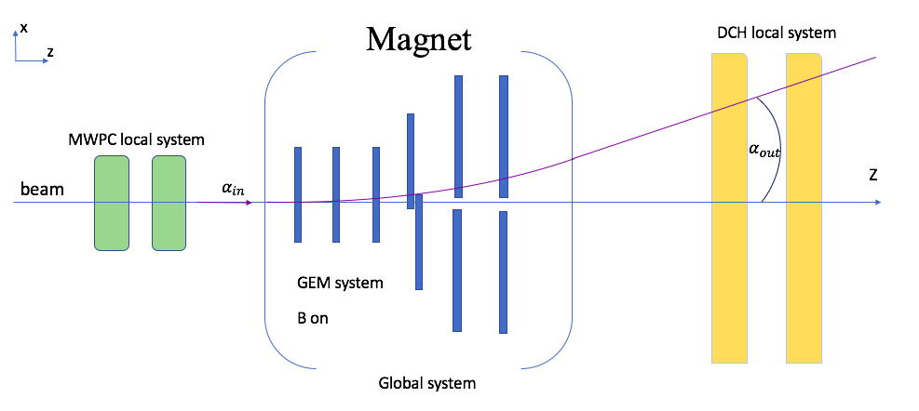
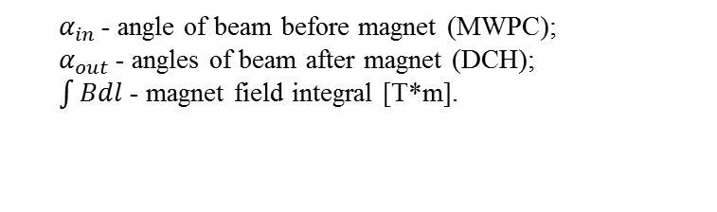
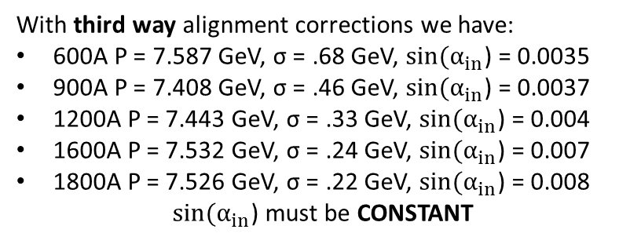
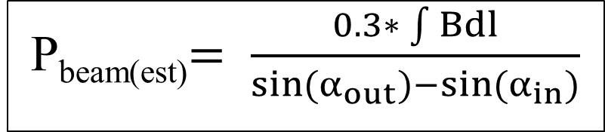
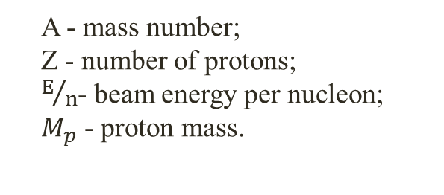
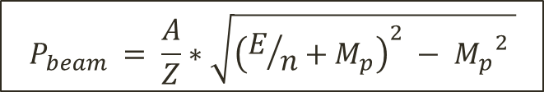
Beam momentum estimation procedure
P_{beam(est)}$= \frac{0.3∗ \int{Bdl}}{\sin{{(α}_{out}{)−sin(α}_{in})}}$
$α_{in }$- angle of beam before magnet (MWPC);
$α_{out }$- angles of beam after magnet (DCH);
$\int{Bdl}$ - magnet field integral [T*m].
With third way alignment corrections we have:
600A P = 7.587 GeV, σ = .68 GeV, ${sin(α}_{in}$) = 0.0035
900A P = 7.408 GeV, σ = .46 GeV, ${sin(α}_{in}$) = 0.0037
1200A P = 7.443 GeV, σ = .33 GeV, ${sin(α}_{in}$) = 0.004
1600A P = 7.532 GeV, σ = .24 GeV, ${sin(α}_{in}$) = 0.007
1800A P = 7.526 GeV, σ = .22 GeV, ${sin(α}_{in}$) = 0.008
${sin(α}_{in}$) must be CONSTANT
A - mass number;
Z - number of protons;
$E/n$- beam energy per nucleon;
$M_{p}$ - proton mass.
$$P_{beam} = \frac{A}{Z}∗\sqrt{{\left(E/n+M_{p}\right)}^{2} − {M_{p}}^{2} }$$
P_beam = 7.0 GeV

Slide 9
Conclusions and possible ways
Nominal Nuclotron beam momentum or energy are given wrong;
The alignment with upstream tracks can give a better picture of alpha_in;
The simplest way is to leave FIRST way alignment and to adjust it later if needed

Slide 10
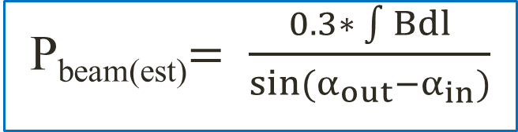
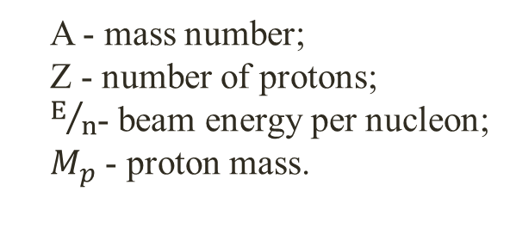
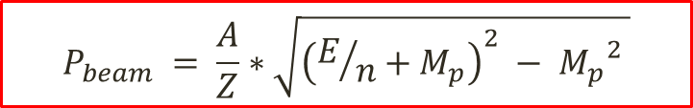
Run6 Momentum vs. Int(BdL)
C beam energy 4.5 GeV/nuclon;
Momentum 10.7 GeV/c;
$$P_{beam} = \frac{A}{Z}∗\sqrt{{\left(E/n+M_{p}\right)}^{2} − {M_{p}}^{2} }$$
P_{beam(est)}$= \frac{0.3∗ \int{Bdl}}{\sin{{(α}_{out}{−α}_{in})}}$
RED – Nuclotron beam momentum;
BLUE – estimated beam momentum.
A - mass number;
Z - number of protons;
$E/n$- beam energy per nucleon;
$M_{p}$ - proton mass.

